Slide 1
Backend Engineering-II Project
Project Name: Hotel Translyvania
Team(3) Details:
Hardik Jain(Team Leader): 2310991837(21-A)
Email ID- hardil1837.be23@chitkara.edu.in
Kanu Priya: 2310991862 (21-A)
Email ID- kanu1862.be23@chitkara.edu.in
Kavita Sharma: 2310991868 (21-A)
Email ID- kavita1868.be23@chitkara.edu.in
L Manjila Singha : 2310991881(21-A)
Email ID - l1881.be23@chitkara.edu.in
Faculty Coordinator: Jatin Arora
:
Chitkara University Institute of Engineering and Technology,

Slide 2
Index
Introduction
Problem Statement
Proposed Design
Technical Details
Code Snippets
Project Github Link
Conclusion

Slide 3
Introduction
The website serves as the online gateway for potential guests, providing essential information and services related to the hotel’s offerings.
Highlights of key facilities such as restaurants, spas, gyms, pools, and event spaces to inform guests of the hotel’s offerings.
Comprehensive descriptions of rooms and suites, including amenities, pricing, and availability, to assist guests in making informed booking decisions.
A section dedicated to showcasing customer feedback and reviews, building trust and credibility for the hotel.
The login and password page allows registered users to securely access their accounts by entering a username and password. It features encryption to protect sensitive information and ensure data privacy.

Slide 4
Problem Statement
Without a website, the hotel is missing out on a critical online presence, making it harder for potential guests to find information or book rooms, which limits the hotel's visibility and accessibility.
Guests often look online for detailed information about a hotel, such as room types, amenities, pricing, and location. Without a website, the hotel may struggle to provide this information easily, which could deter potential customers.
A website allows the hotel to collect guest reviews and testimonials, which are valuable for marketing and improving services. Without a website, the hotel misses the chance to build its reputation through customer feedback
In today's digital age, travelers expect a professional, easy-to-navigate website to verify the legitimacy and quality of a hotel. A lack of a website can make the hotel seem less trustworthy or outdated.
The solution is to develop a dynamic and responsive website that offers an engaging user experience, easy navigation, and comprehensive information about the hotel.

Slide 5
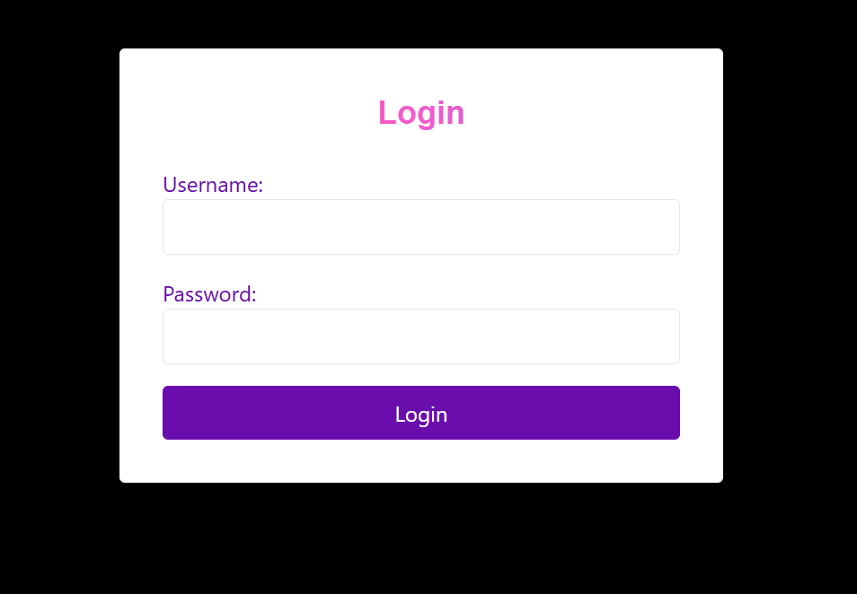
Proposed design
Login and Password page:
The login and password page allows registered users to securely access their accounts by entering a username and password. It features encryption to protect sensitive information and ensure data privacy.

Slide 6
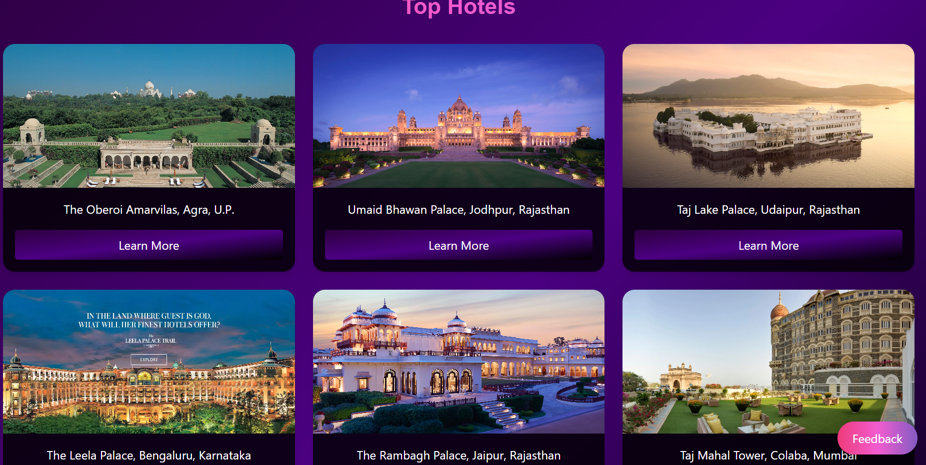
Proposed Design
Hotel Chain Locations Page
A dedicated page showcasing all the hotels within the chain, highlighting their locations, amenities, and unique offerings.This feature makes it easier for guests to explore other properties within the chain, allowing for seamless travel planning and cross-property bookings.
10

Slide 7
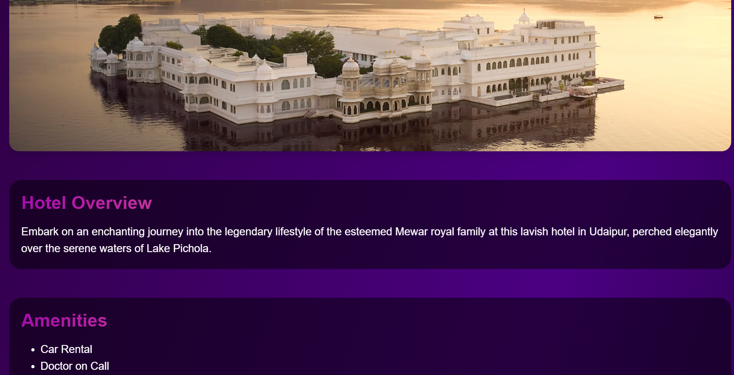
Proposed Design
Room and accommodation Details:
Detailed descriptions of rooms and suites, including amenities, pricing, and photos, allowing guests to understand what to expect before booking.

Slide 8
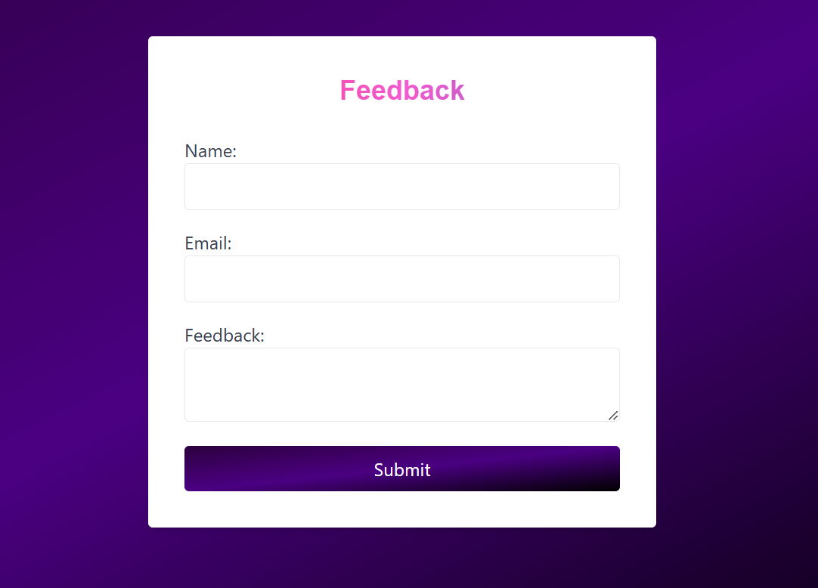
Proposed Design
Feedback and Suggestions Section
A dedicated area where guests can leave their feedback, suggestions, and reviews after their stay. This helps the hotel gather valuable insights into guest experiences, improve services, and enhance customer satisfaction.
7

Slide 9

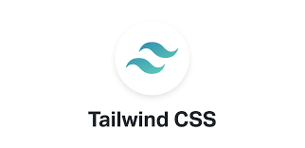




Technical details

Slide 10
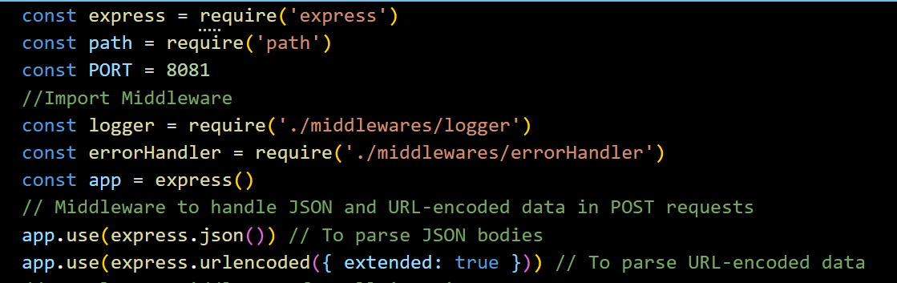
Code Snippets
Use Of Express.js

Slide 11
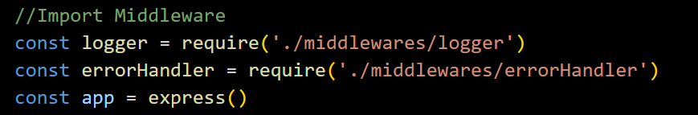
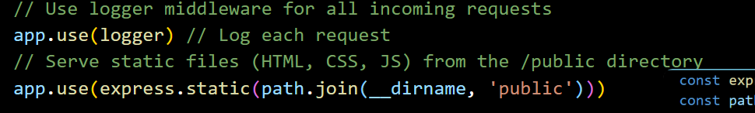
Code Snippets
Middlewares - Logger
ErrorHandler

Slide 12
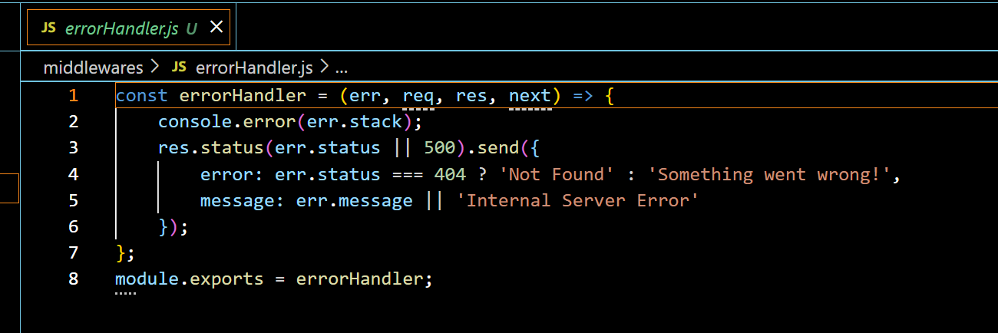
Code Snippets
Error Handler Middleware

Slide 13
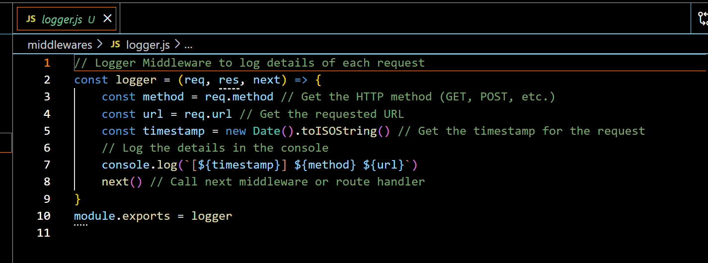
Code Snippets
Logger Middleware

Slide 14
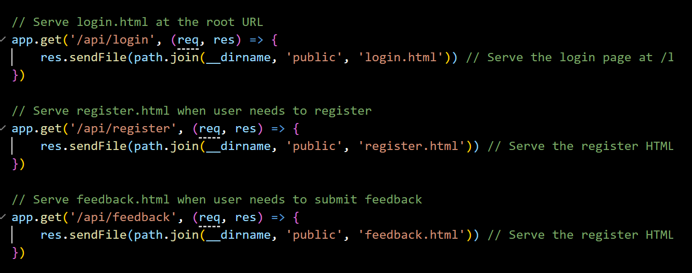
Code Snippets
Use Of API

Slide 15
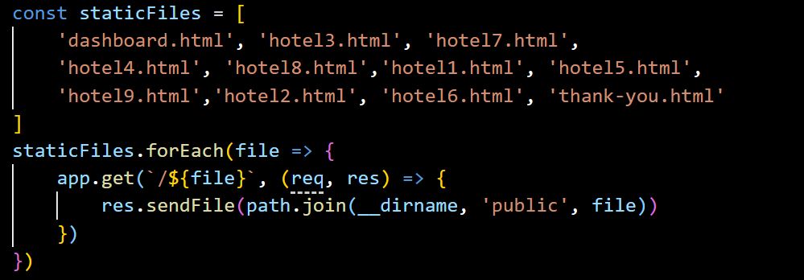
Code Snippets
Integrating Express.js with Frontend

Slide 16
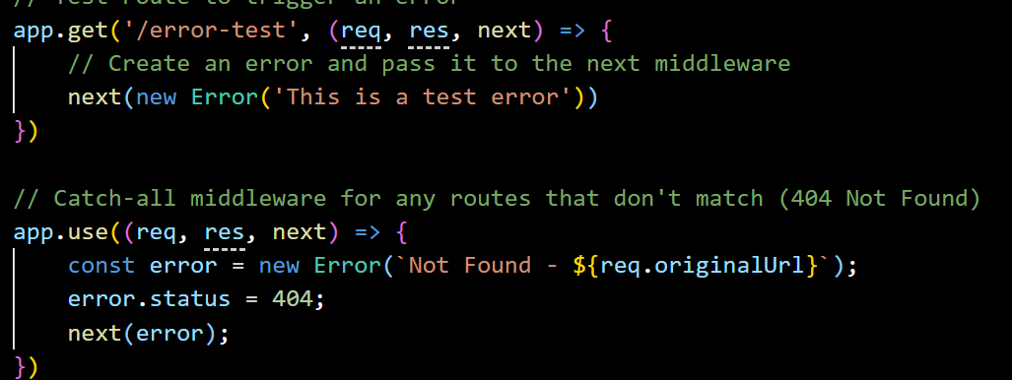
Code Snippets
Error Handling

Slide 17
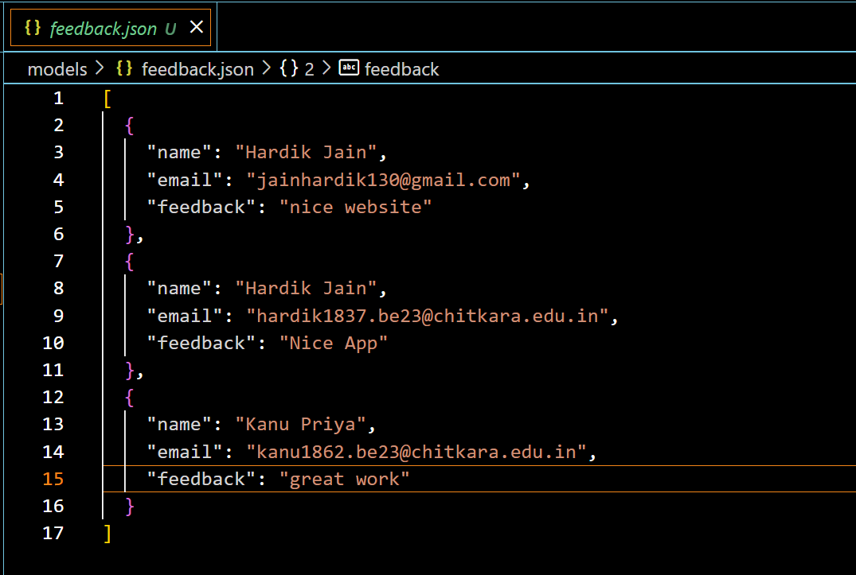
Models
1. feedback.json

Slide 18
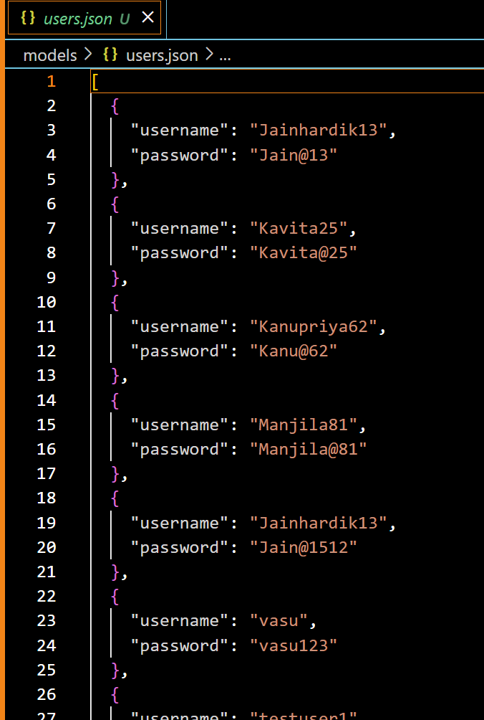
2. Users.json

Slide 19
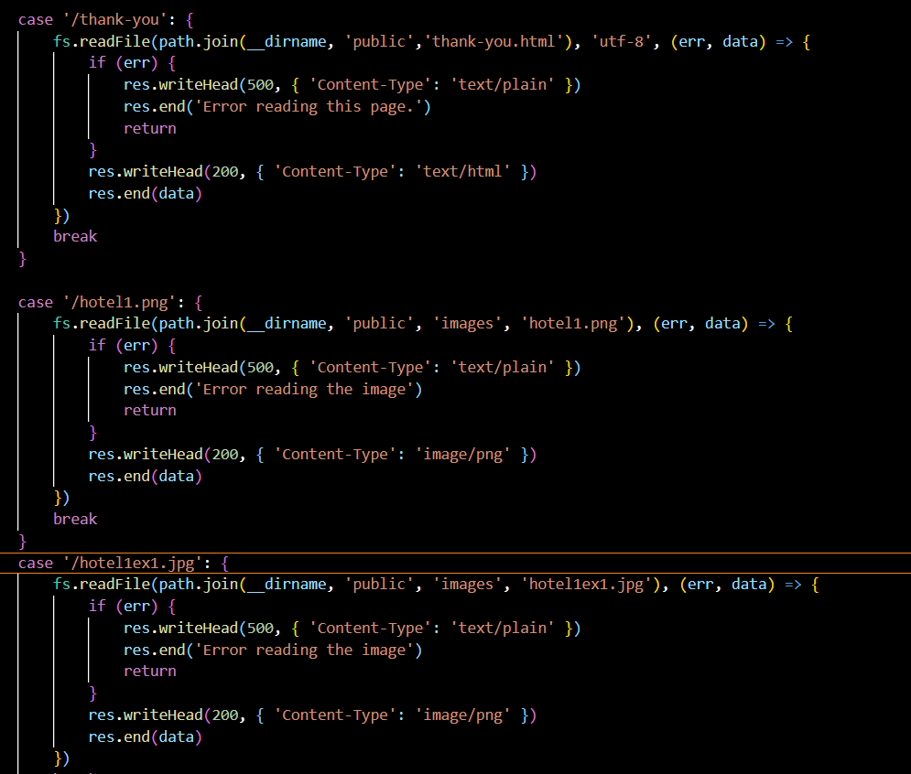
Use of Express.js over HTTP has reduced the size of our code from 1500 lines to 96 lines which made it short and precise. Instead of integrating each static file separately, we can use a loop to integrate it together.
Earlier

Slide 20
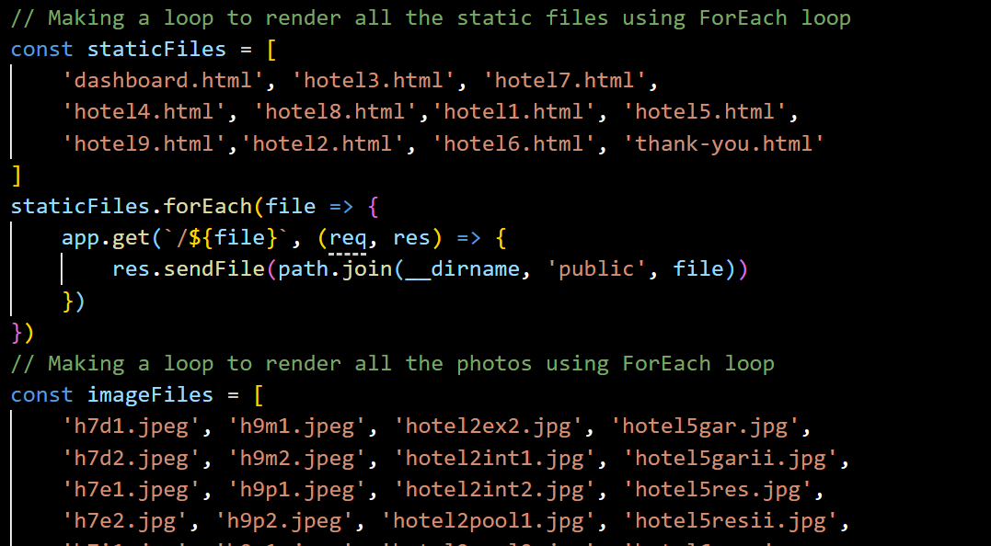
Using express.js

Slide 21
Project GitHub Link
Title: Hotel Transylvania Project on GitHub
Link : https://github.com/jainhardik13/Hotel-Transylvania.git
Description: The website serves as the online gateway for potential guests, providing essential information and services related to the hotel’s offerings.

Slide 22
Conclusion
A well-designed hotel website significantly enhances the hotel's online presence, making it easier for potential guests to find and explore the services offered. A strong digital presence is crucial in the competitive hospitality industry.
Providing comprehensive details about rooms, pricing, amenities, and special offers helps customers make informed decisions. Clear and transparent information builds trust and encourages direct bookings.
High-quality images, virtual tours, and customer reviews on the website improve credibility and attract more visitors. A visually appealing and informative website can influence potential guests to choose the hotel over competitors.

Slide 23


